Slide 1
Path to becoming immortal
Jake

Slide 2
Permissions granted to user
Overall system permissions
They can get locked out of being able to type in the taskbar if it is not required and may be a distraction.
They can be locked out of editing the background or changing the system information if they do not have a high enough clearance to access it.
They can be restricted to only being allowed to do simple tasks only related to the work and the cmd console can be remotely locked so that it cannot be edited in any way.
They can be allowed to use all preinstalled systems without having access to software or game centre to install or uninstall things.
Folder permissions
You can set people to only be able to View file names and subfolders inside the system.
User ability to navigate around folders and edit them. Without this the system is completely locked down as they cant navigate within the system.
Users can add or remove files if they have been granted the folder permissions to use the sub folder.
If a user has either admin privileges or similar, they can change their own permissions or other folder permissions within the system.
They can take ownership of the entire file if they have been given permissions.
Justifications
One of the possible reasoning for this is to prevent users from accessing, overwriting or deleting sensitive data. Having these systems in place can prevent time being wasted on restoring data that has been edited wrongly.

Slide 3
Whitelisting, Blacklisting and Web Filters
Whitelist
The ability to default deny permissions towards new people in case they are new to the system
It will use a list of apps, software and domains within the internet that have been allowed for the user and it will be the only thing they will do by default
Anything not on the list gets denied access and they cant do anything outside of work
Blacklist
Instead of denying being the default, it will accept the majority of things that get searched.
It will have a short list of things that have been denied and if you search something related to anything on the list it will deny access and wont let you view it. Examples can include things not related to work as this could be a distraction during work times.
Anything that is not on the list will be allowed and the user will get almost full access to it.
Web Filters
Web filters are programs that allow Administrators to control what people can search for on internet browsers.
One of the reason for this is that it can prevent users from going onto suspicious websites that haven’t been added to the blacklist or simple restrict websites not suitable for the current situation (work).

Slide 4
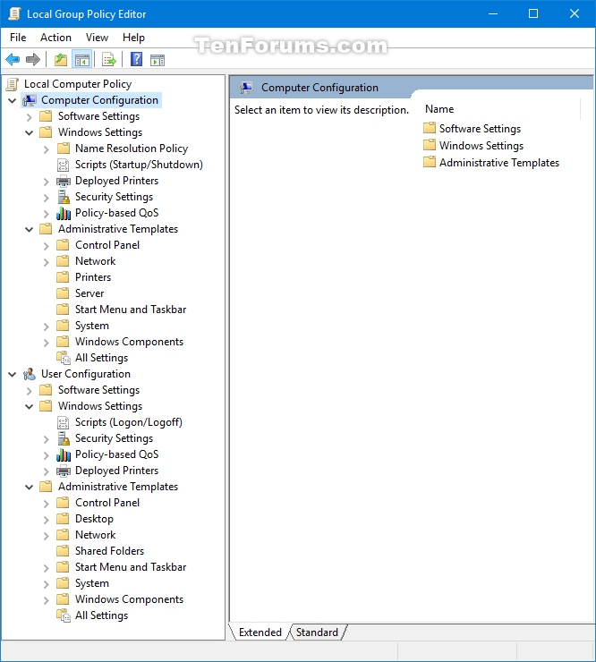
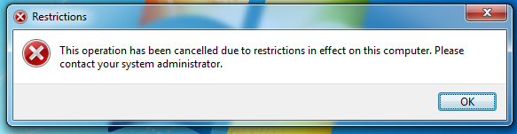
Group policies
Centralized group policies
It can be used for locking down computers and restricting access to specific folders, control panel uses or applications within the computer. This can also be used to change a range of windows settings which have been otherwise locked down for the user
Local group policies
Local group policies are used to control specific computer systems without it affecting an entire network. This allows the policy manager to control certain aspects of computers that are being used incorrectly.
Justification
Being able to dictate what a user have access too can limit exposure to hazardous websites or restricted files. This can limit the damage a user can do to files they shouldn't have access to by restricting what they are able to do to those files.
This can save company time and resources because it would prevent a large amount of unauthorised access to sensitive files.

Slide 5
Test Plan
Test No. | Test | Expected Result | Actual Result
1 | Ensure Anti virus scans periodically (every two days) | For the Anti virus scan every two days correctly
2 | Ensure users of a specific level have full access to folders of their level | Users of a specific level have full access to folders of their level
3 | Ensure users of a specific level do not have access to levels above them | Users do not have access to levels above their current level
4 | Ensure users are able to modify specific files above their current level | Users are able to modify specific files above their current level
5 | Ensure users get a prompt to change their passwords every two weeks | Users get a prompt to change their passwords every two weeks
6 | Ensure users are unable to access to blacklisted sites | Users are unable to access to blacklisted sites
7 | Ensure users are able to access whitelisted sites | Users are able to access whitelisted sites
8 | Have Hidden files | Have folder/files hidden to users that have a restriction level of below ‘Administrator’
9 | Have a physical USB access Key | Have physical keys for computer to allow lesser users access to advance options.
10 | Restrict access to Command prompt | Restrict user’s access to the Command prompt if they have below ‘Administrator’ access.

Slide 6
Evaluation
Due to time restrictions we were unable to setup a effective scanning system to scan daily and weekly. The initial plan was to scan lightly at the end of the day and then do thorough scans at the end of every week.
I had wanted to create 4 levels of access depending on a users time with the system; temporary users would have minimum access which would change over a course of 2 weeks, then the account would evolve into a semi-permanent account would have less restrictions and have limited access to the internet, after 2 weeks it would then evolve into a permanent local account with access to modifying and moving permissions and after that if the experienced employees believe that the user deserves to be designated to a ‘Administrator’ then the new user would have almost unrestricted access.
Each level of restriction would have had a specific amount of access towards internet browsing and file/folder access. For example: Temporary users can only use the internet for education purposes and can only see files that holds no significant importance, Semi-Permanent users can use the internet in addition for news browsing, Local accounts can browse forms of video viewing alongside being able to view folders that other users below in restriction have made and Administrators can view most forms of media in addition to viewing all established folders.

Slide 7
Review of the System’s Protection
With the use of the on-board windows defender we were able to setup a system where it would skim through folders and files daily and scanning thoroughly weekly at the end of each days shift.
Levels of access and restrictions were put in place to prevent users for accessing and modifying important files/folders. This would cause the user to get a prompt when attempting to do a restricted action.
For each new user a password window will prompt them to make a new password which abides to the password rules, then after the new password has been authorised it will be prompted again in two weeks to change it again.
Users that are below the access level of ‘Administrator’ will have websites blocked to prevent system damages. User’s will also have restricted access to important files and specifically important files will be hidden to users below certain levels.
The command prompt was also restricted to users below the access level of ‘Administrator’ to prevent misuse.

